Slide 1
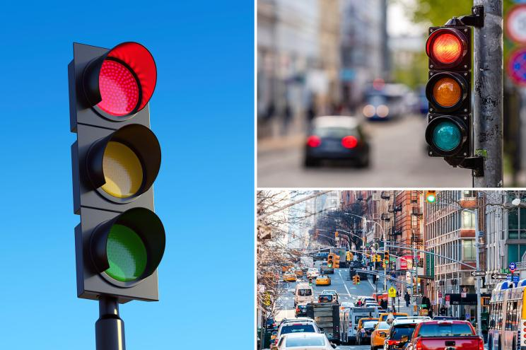
EL527 – ASIC Design
Traffic Light Controller
Design and Implement a sensor based intelligent traffic light controller system for a highway-sideroad intersection.
The system is built using FSM logic and has been implemented in Verilog.
Write a testbench and perform simulation of functional verification of the system.
Synthesize RTL code using Qflow to automate the digital ASIC design flow.
Instructor: Prof. Rutu Parekh

Slide 2
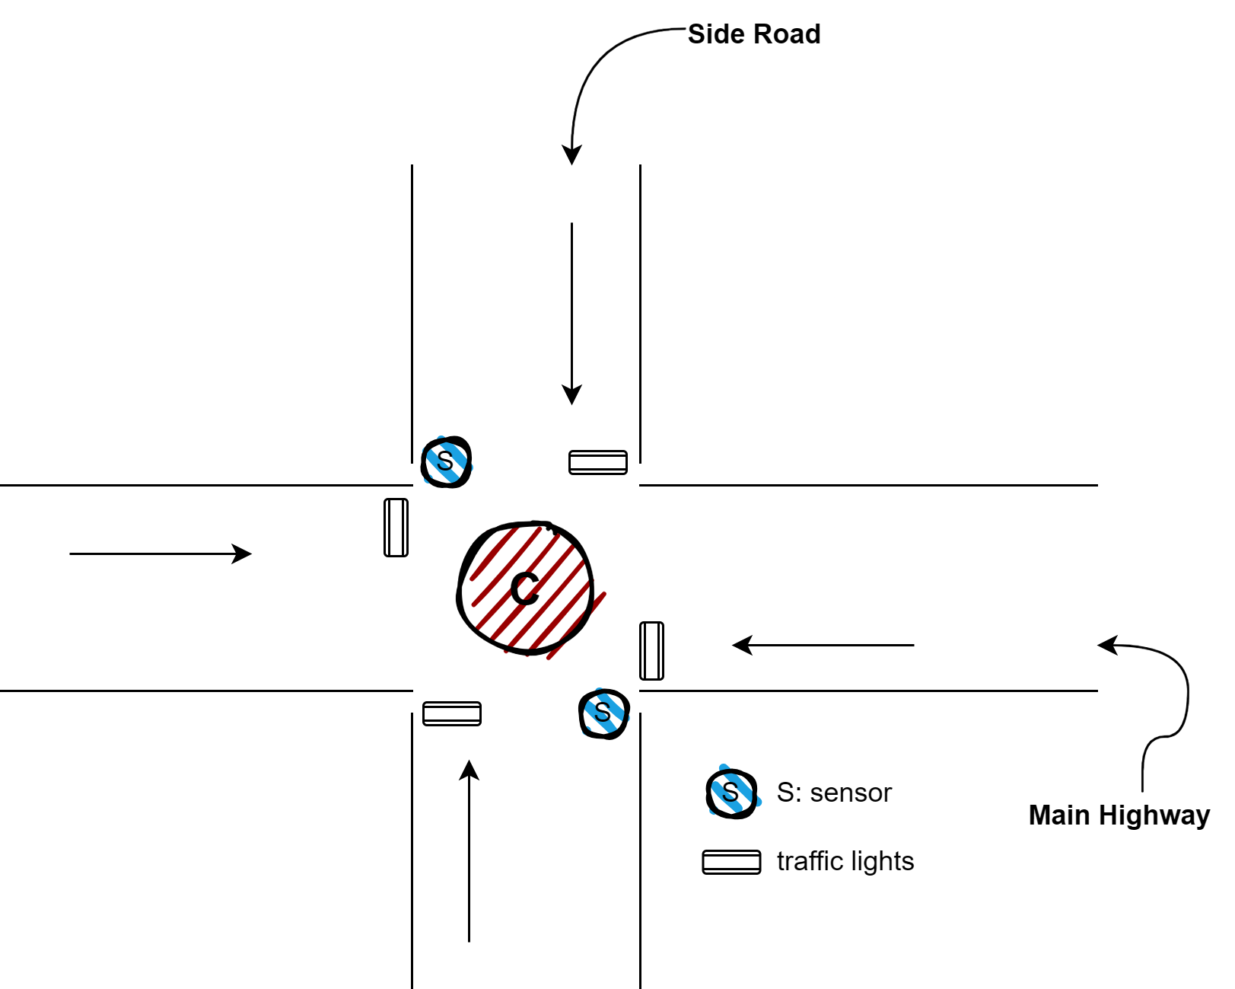
Introduction
Efficient traffic control is crucial for managing congestion and ensuring road safety.
Traditional timing-based controllers often lack real time responsiveness, which leads to delay and fuel consumption.
My project presents an intelligent traffic light controller, to ensure uninterrupted highway flow while adaptively giving access to sideroad when vehicles are detected.
The design uses controlled delays for yellow and all-red periods, enhancing safety during signal transitions. Simulation results and QFlow synthesis validate its suitability for hardware implementation, offering a practical solution for adaptive traffic control in smart cities.

Slide 3
System Overview and Requirements
The traffic light controller manages traffic flow at a four-way intersection, prioritizing the highway and responding to sideroad vehicle presence via sensor input. The system's core is a Finite State Machine (FSM) that governs traffic signal behavior based on real-time inputs and internal timing. The design is modeled in Verilog and synthesized using open-source tools.
1
Real-time Responsiveness
Adapts to changing traffic conditions.
2
Enhanced Safety
The highway signal remains green by default, and a sensor sends a binary input X to the controller (X = 1 if cars are detected on the sideroad). When X = 1, the FSM transitions to allow a green signal to the sideroad for a limited time, with yellow and all-red phases included for safety.
Includes programmable delay counters for safe transitions.
3
Physical design
Validated through simulation and QFlow synthesis.
Default Behavior
Sideroad Detection
Highway green for uninterrupted flow.
Sensor input triggers priority switching.

Slide 4
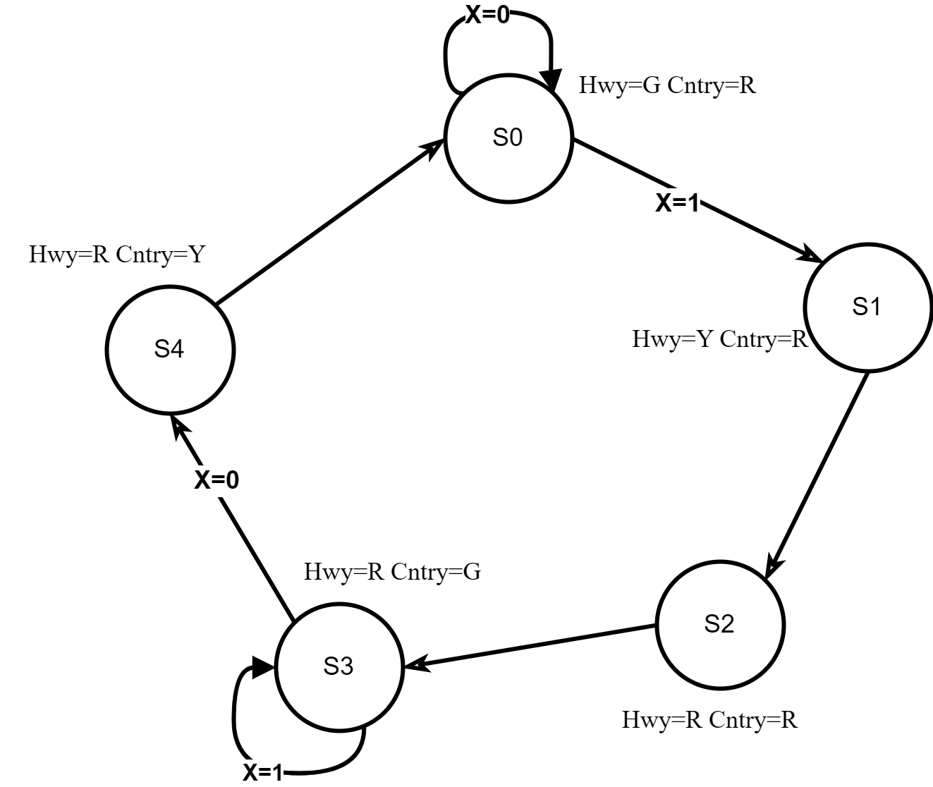
FSM Design and States
S0: Highway Green
1
2
S1: Highway Yellow
S2: All Red
3
4
S3: Sideroad Green
S4: Sideroad Yellow
5
States:
S0: Highway GREEN, Sideroad RED (default)
Transitions occur based on vehicle presence (X) and delay completion.
When no vehicle is detected, the controller cycles back to S0, restoring highway priority.
S1: Highway YELLOW, Sideroad RED (warning)
S2: Highway RED, Sideroad RED (safety delay)
We can use IR sensor, loop inductive sensor or Ultrasonic sensor to handle the
value of X (presence of vehicles on sideroad).
S3: Highway RED, Sideroad GREEN (sideroad access)
S4: Highway RED, Sideroad YELLOW (warning)

Slide 5
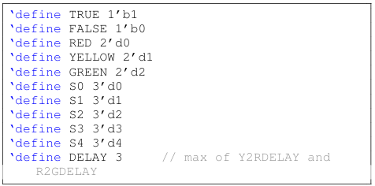
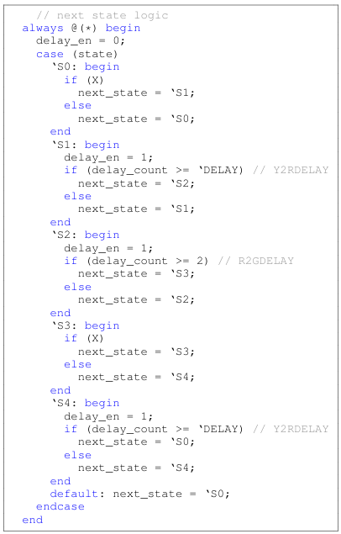
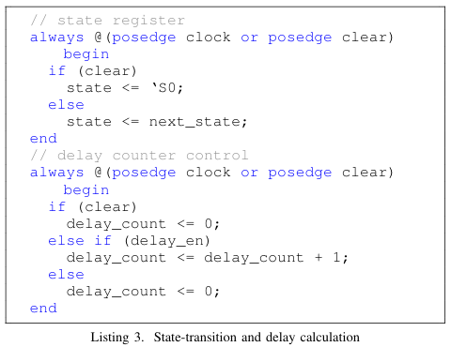
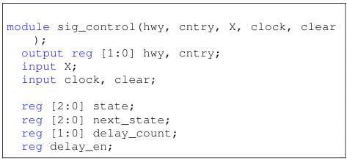
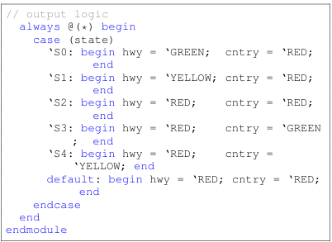
Verilog Code Overview

Slide 6
Continued …
The Verilog code defines five states (S0 to S4) and handles transitions based on vehicle presence input X and timing delays. The FSM uses delays in critical states (S1, S2, S4) to enforce safety intervals, while sensor input (X) dynamically prioritizes sideroad access. The code includes state-transition logic, delay counter control, and output logic to manage traffic light signals.
Key elements include defining enums for lights/states, module instantiation, state-transition and delay calculation, and next-state calculation. The output logic assigns appropriate colors to the highway and sideroad lights based on the current state.
State Definitions
Delay Control
Output Logic
Five states from S0 to S4.
Enforces safety intervals.
Assigns colors to traffic lights.

Slide 7




Simulation Results and Validation
s0_to_s1
s1_to_s2
s2_to_s3

Slide 8






s3_to_s4
s4_to_s0
Highway Green
Initial state.
Simulation waveforms validate the functional correctness of the FSM-based traffic light controller. Transitions are based on input 'x', timer conditions, and the current FSM state. Outputs, including highway and sideroad signals, follow deterministic clocked behavior, ensuring traffic rules are enforced. The simulations confirm sequential state progression and proper handling of safety delays.
The FSM always returns to the initial Highway Green (S0) state, maintains mutual exclusivity, and responds correctly to sideroad traffic detection. Minimum safety delays are honored, and the system resets to highway control once sideroad traffic clears.
Sideroad Detection
Transitions to sideroad access.
Safety Delays
Ensures collision-free switching.
Highway Control
Resets after sideroad traffic clears.

Slide 9
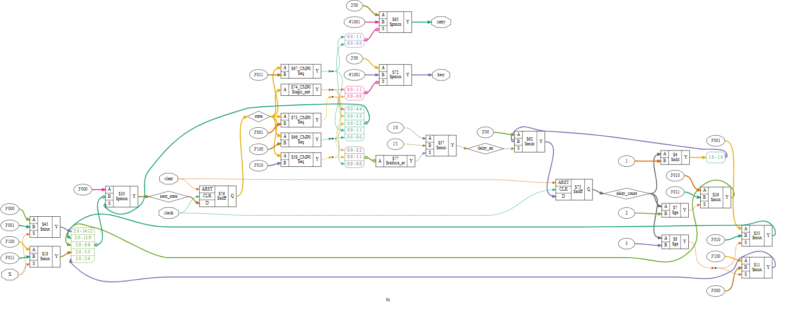
RTL Schematic using yosys0.37 in EDA Playground
RTL Diagram

Slide 10




Synthesis Using QFlow
QFlow, an open-source toolchain, automates the ASIC design flow, transforming Verilog descriptions into manufacturable layouts. It integrates tools like Yosys, GrayWolf, QRouter, and Vesta. In this project, QFlow synthesized the Verilog RTL, placed and routed the design, and validated functionality through STA and DRC/LVS checks. This underscores its practicality for academic and low-volume ASIC development.
Synthesis
Placement
RTL to gate-level netlist.
1
2
Arranges standard cells.
4
3
Verification
Routing
STA, DRC, and LVS checks.
Connects placed cells.

Slide 11
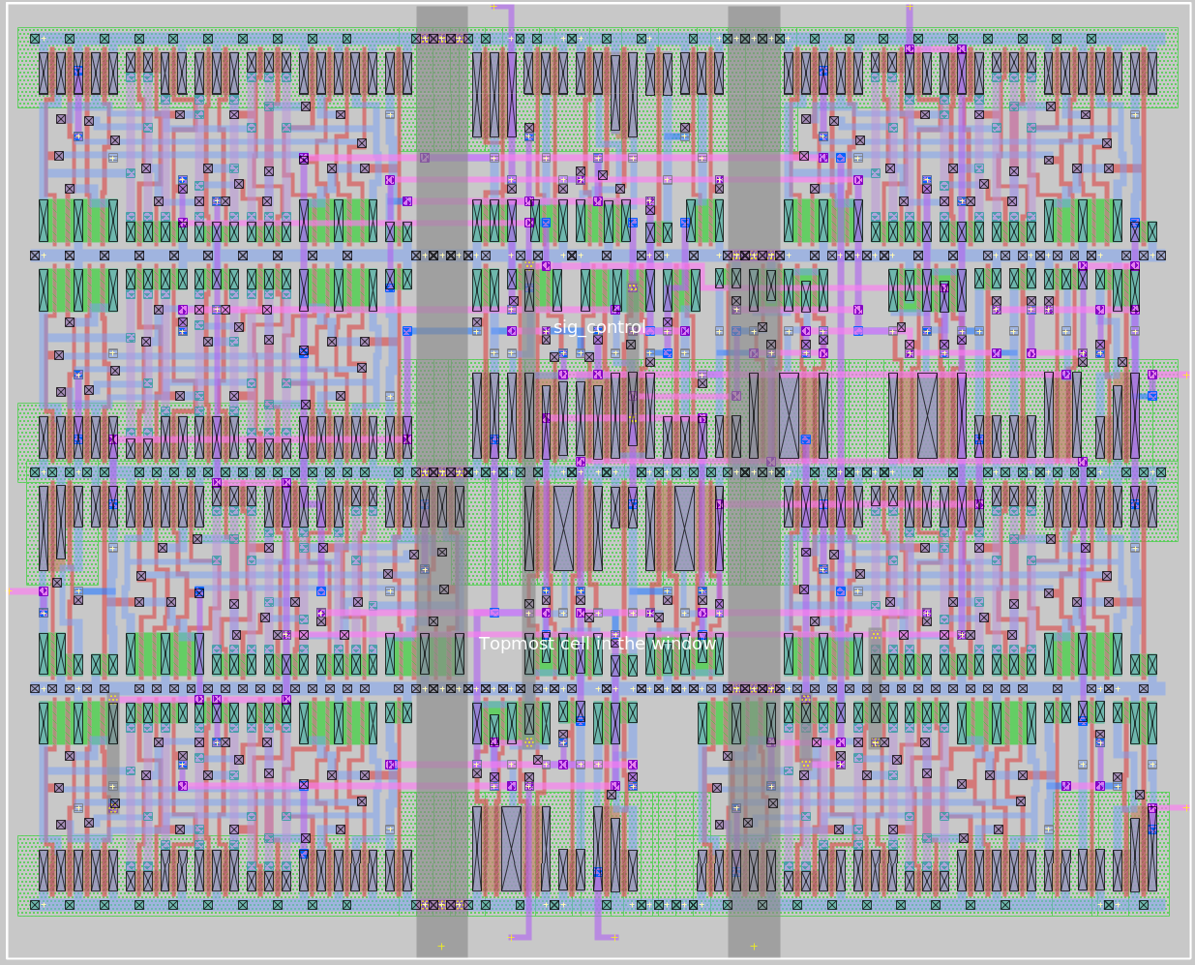
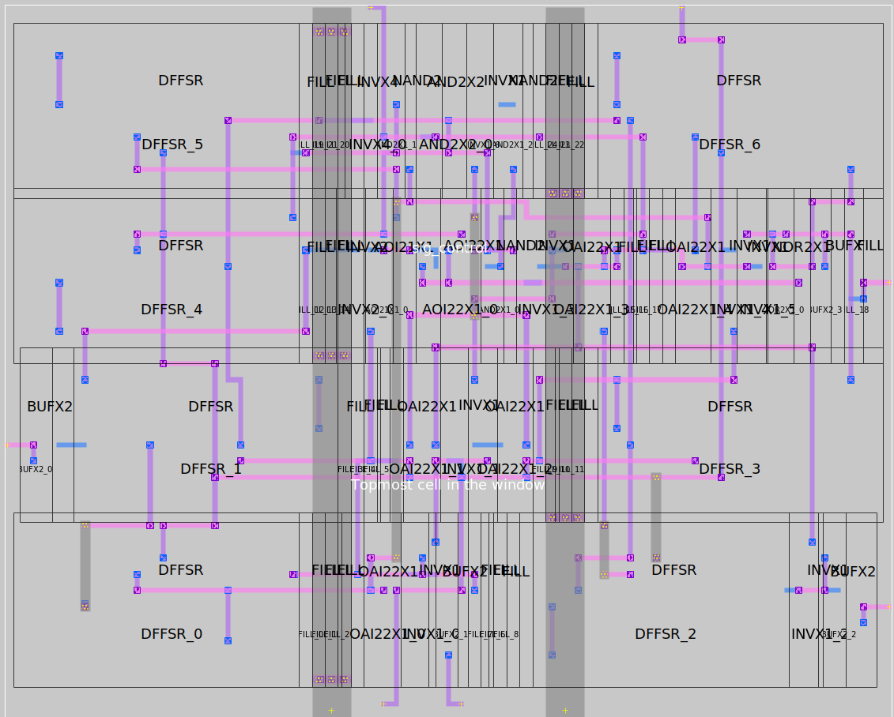
QFlow Synthesis Results and Verification
Layout view
GDS layout

Slide 12
Continued …
QFlow generates a fully routed layout of the traffic light controller after successful synthesis, placement, and routing. The final physical design shows the organized arrangement of standard cells and completed interconnect routing. QFlow automatically performs static timing analysis to verify that the design follows the setup and hold time requirements.
Once all timing and physical verification checks are passed, the design is considered sign-off ready and can proceed to manufacturing validation steps and integration into a larger SoC environment.
1
Synthesis
2
Placement
3
Routing

Slide 13





Conclusion and Future Improvements
The presented controller prioritizes highway flow while adjusting sideroad access dynamically. Hence, the controller helps improve traffic flow, and enhances road safety.
Key features include delay counters for safe transitions and validation through simulation and QFlow synthesis.
Future improvements could focus on expanding the design to accommodate multi-lane intersections and pedestrian phases..
Considering false sensing and fault tolerance could also improve system performance.
Efficiency
Safety
Innovation

Slide 14

Thank you
Group 17
Divyarajsinh - 202201155

